Slide 1

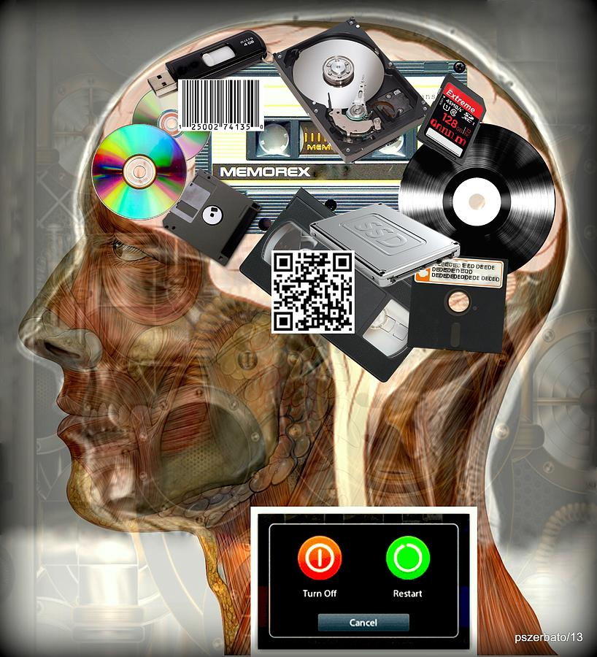
Introduction to Computer Science
Reichman University
Lecture 5-2
Multimedia, Part I
Notes:
1

Slide 2
The big picture
any program you may want to write
objects
handling text, graphics, sound
arrays
functions
conditionals and loops
Math
text I/O
primitive data types
variables

Slide 3
The big picture
any program you may want to write
objects
handling text, graphics, sound
this lecture
arrays
functions
conditionals and loops
Math
text I/O
primitive data types
variables

Slide 4
Lecture plan
Text
Graphics
Animation
Audio

Slide 5
Standard output
Shell / terminal / cmd prompt / cmd:
public class RandomNumbers {
public static void main(String[] args) {
int N = Integer.parseInt(args[0]);
// Prints N random numbers in [0,1)
for (int i = 0; i < N; i++) {
System.out.println(Math.random());
}
}
}
% java RandomNumbers 5
0.4234137005317864
0.2984657006398488
0.7456080688315734
0.0038273723723723
0.8734883483448448
%
Shell: An interactive OS program that enables managing files and executing programs, using text-based commands
“Standard output”: The stream of characters that a program writes; By default, goes to the shell.
Java’s print / println / printf functions write to standard output.

Slide 6
Standard input
Shell / terminal / cmd prompt / cmd:
/** Reads numbers and prints their average */
public class Average {
public static void main(String[] args) {
// Creates an In object for representing standard input
In in = new In();
double sum = 0.0;
int n = 0;
while (!in.isEmpty()) {
double x = in.readDouble();
sum = sum + x;
n++;
}
System.out.println("Average: " + sum / n);
}
}
% java Average
10
20
30
Average: 20.0
%
In each line the user types something and presses “enter” (which produces a “newline” character)
Here the user entered an input termination character: ctrl-d (in mac / unix)
ctrl-z (in windows)
“Standard input”: The stream of characters that a program reads; By default, comes from the keyboard.
Java provides no simple way to read inputs from standard input;
In: An open source class for handling standard input, used in this course.

Slide 7
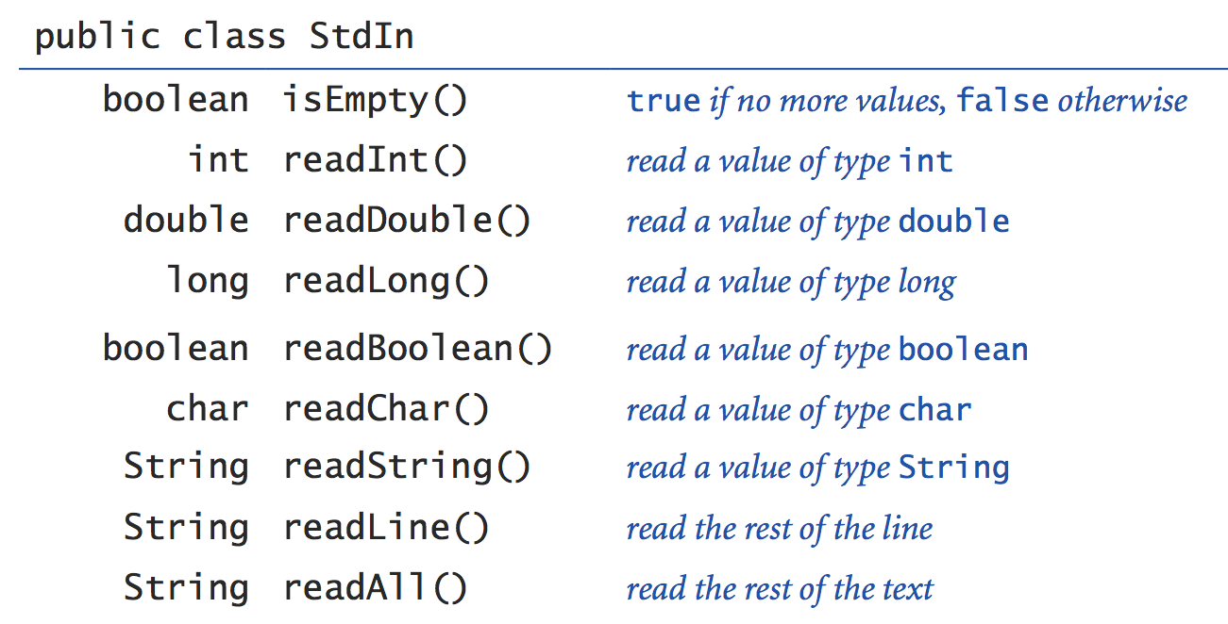
The In class
In: a library for handling standard input:
In API (click)
. . .

Slide 8
Redirection
(Previous examples):
% java RandomNumbers 3
0.4234137005317864
0.2984657006398488
0.7456080688315734
% java Average
100
200
100
300
<ctrl-d> / <ctrl-z>
Average: 175.0
%

Slide 9
Redirection
(Previous examples):
Redirection examples:
% java RandomNumbers 3
0.4234137005317864
0.2984657006398488
0.7456080688315734
% java Average
100
200
100
300
<ctrl-d> / <ctrl-z>
Average: 175.0
%
% java RandomNumbers 1000 > data.txt
% more data.txt (more: OS utility for viewing a file)
0.05589098017497873
0.5792882827583564
...
% java Average < data.txt
Average: 0.48881491492997764
% java RandomNumbers 1000000 | java Average
Average: 0.4999861238602861
%
Redirection operators
> fileName: Directs standard output to a file
< fileName: Directs standard input from a file
process1 | process2: Pipes the output of process1 into the input of process2

Slide 10
Lecture plan
Text
Graphics
Animation
Audio

Slide 11
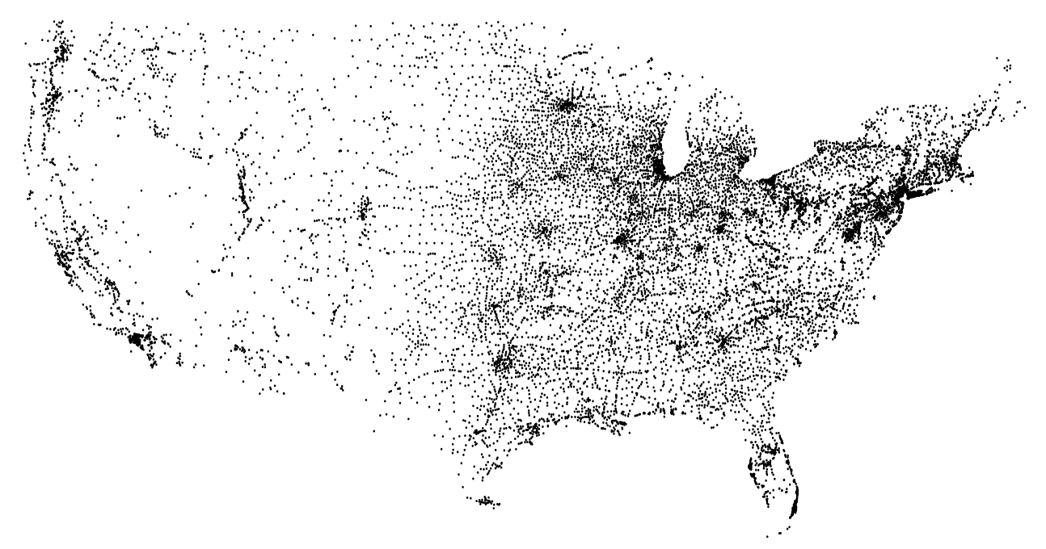
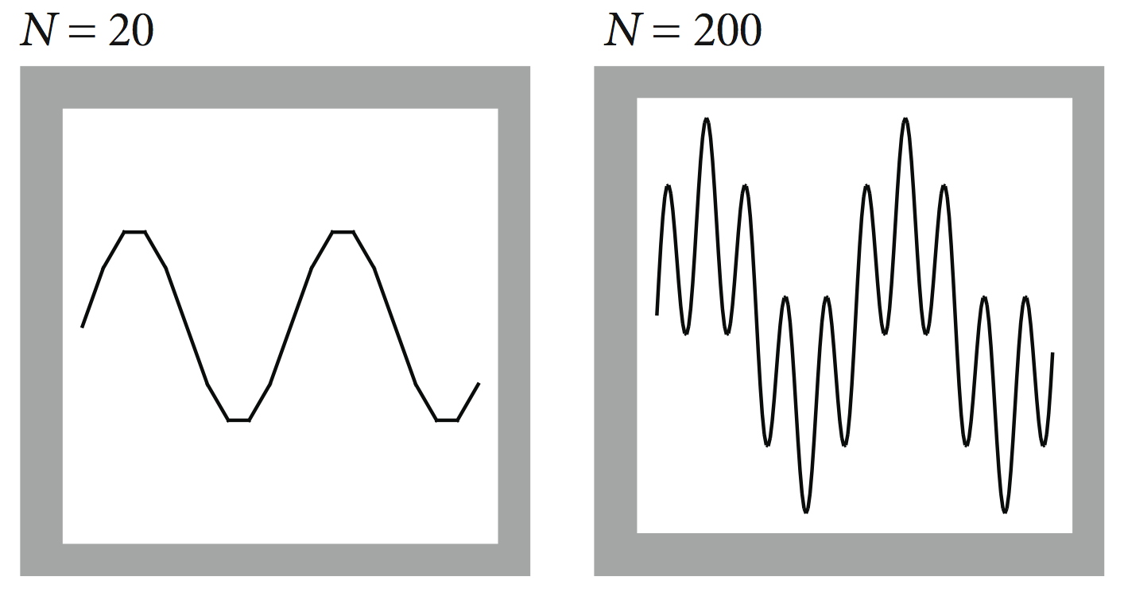

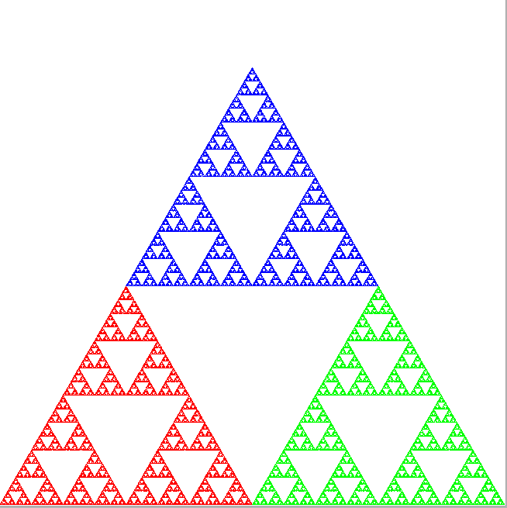
Graphics
Computer graphics: The art and science of displaying and manipulating images
The science: Building a mathematical model
The art: Implementing the model using a library of graphics primitives: draw a point, draw a line, draw a circle, etc.
StdDraw: An open source graphics class, used in this course.

Slide 12
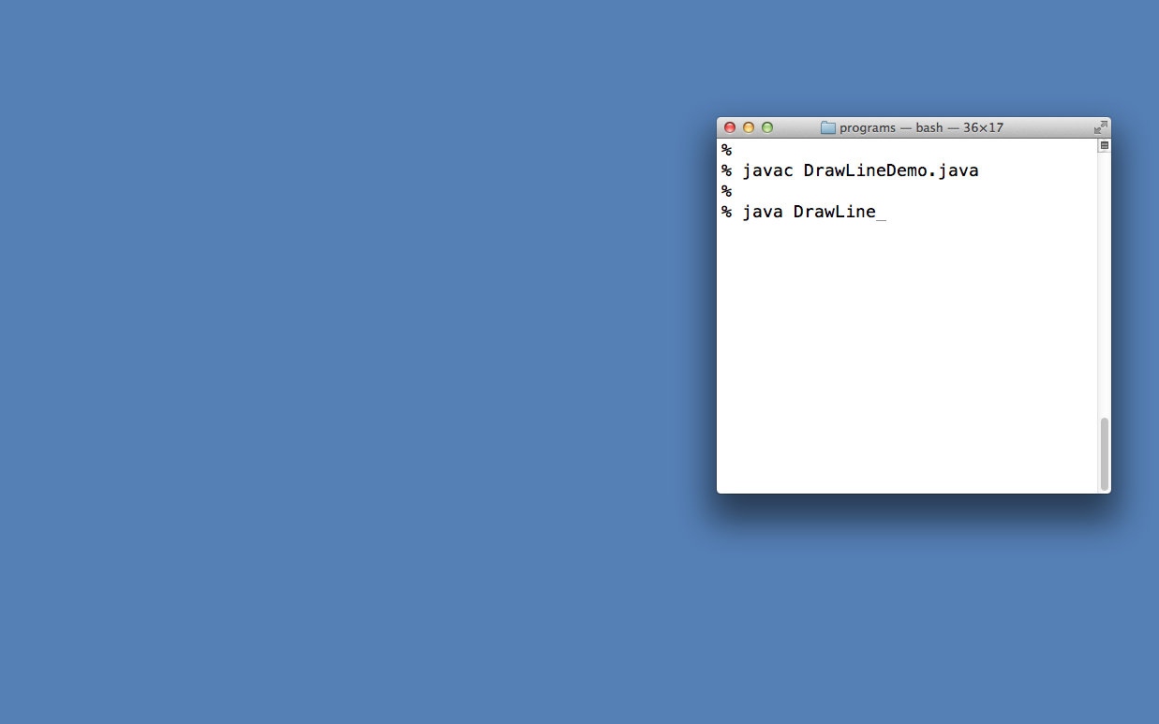
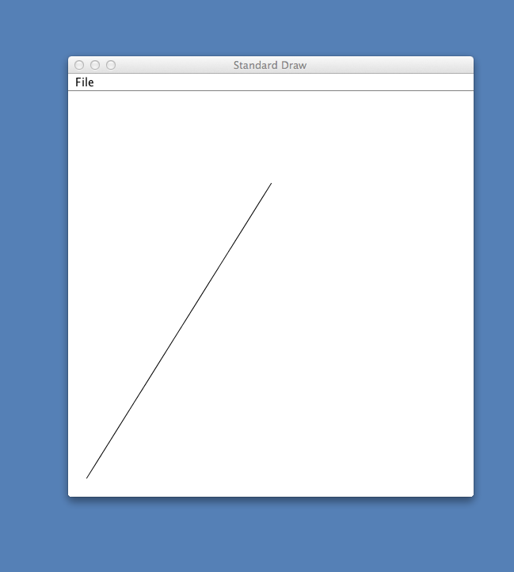
“Canvas” (drawing area)
(0.5, 0.8)
Screen
canvas
(0, 0)

Slide 13
“Canvas” (drawing area)
(0.5, 0.8)
512 pixels
Screen
canvas
(0, 0)
512 pixels
1.0
Physical view: a ”canvas” consisiting (by default) of 512 rows of 512 pixels each, which includes an invisible 10-pixel all around “frame”

Slide 14
“Canvas” (drawing area)
(0.5, 0.8)
1.0
Screen
canvas
(0, 0)
(0, 0)
1.0
1.0
Physical view: a ”canvas” consisiting (by default) of 512 rows of 512 pixels each, which includes an invisible 10-pixel all around “frame”
Logical view: a 1.0 by 1.0 coordinate system, (0,0) at the bottom-left corner.

Slide 15
Line drawing
public class DrawLineDemo {
public static void main(String[] args) {
// draws a line between (0,0) and (0.5,0.8)
StdDraw.line(0.0, 0.0, 0.5, 0.8);
}
}
Notes:
StdDraw creates a default canvass
The default canvas dimensions, line width, colors, etc. can be easily changed using StdDraw functions.
(0.5, 0.8)
Note: to stop a program that creates a graphical window, close the window
(0, 0)

Slide 16
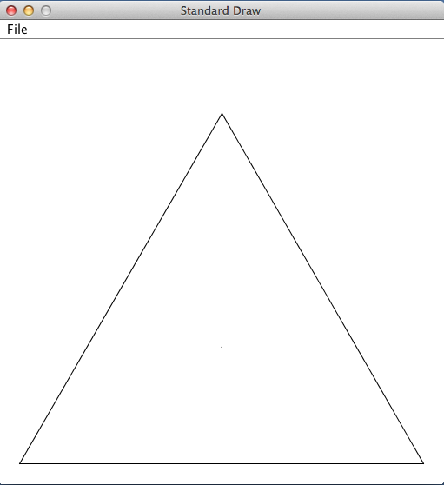
Line drawing
Task: Draw an equilateral triangle with side length 1; Left bottom corner at (0,0).
?
(x , y)
% java EqTriangle
%
use geometry to compute the the top vertex (x, y)
1
1
1
1
h
(0, 0)
1
(1, 0)
(0, 0)
(.5, 0)
(1, 0)
public class EqTriangle {
public static void main(String[] args) {
//// You do it, using StdDraw.drawLine()

Slide 17
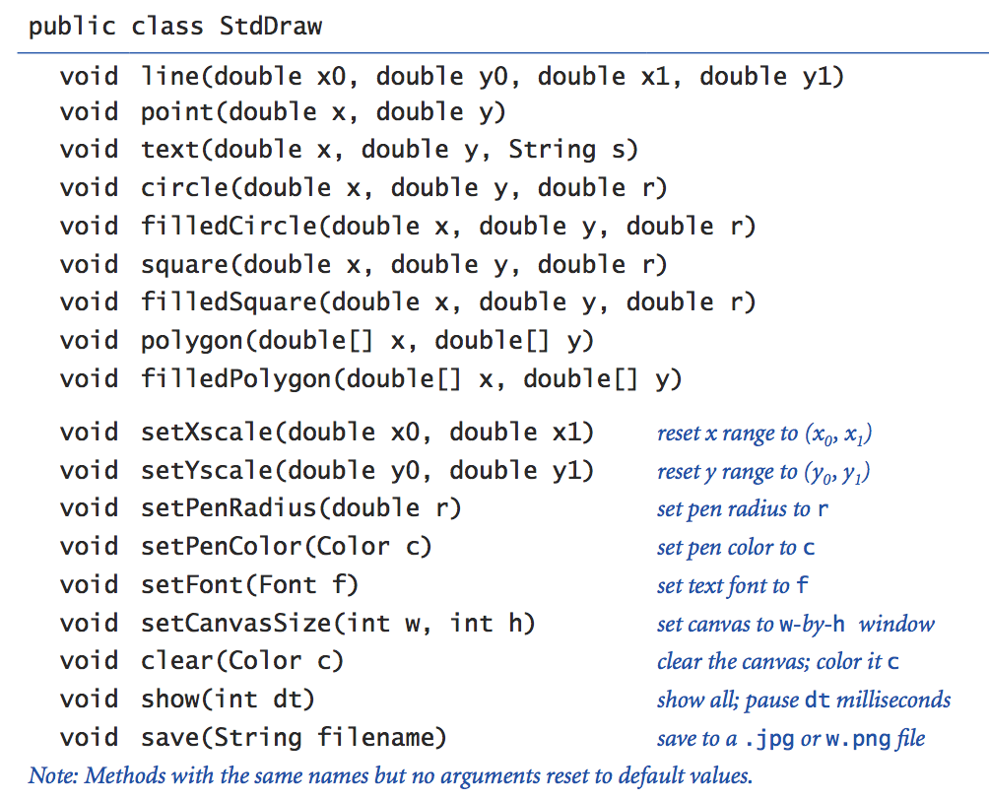
The StdDraw class
StdDraw: a library for drawing graphics
Complete API (click)

Slide 18
Data visualization
Given: Geographical coordinates of 13000+ cities and villages (with population > 500)
Task: Make the data visible
convention: first 4 values are the
data’s xMin, yMin, xMax, yMax
% more USA.txt
669905.0 247205.0 1244962.0 700000.0
1097038.8890 245552.7780
1103961.1110 247133.3330
1104677.7780 247205.5560
1108586.1110 249238.8890
...
% java PlotMap < USA.txt
1200 by 800 pixels canvas
yMax
yMin
xMin
xMax

Slide 19
Data visualization
Given: Geographical coordinates of 13000+ cities and villages (with population > 500)
Task: Make the data visible
convention: first 4 values are the
data’s xMin, yMin, xMax, yMax
/** Reads data points (geographical coordinates) from a file,
* and draws them. */
// Uses classes In, StdDraw
public class PlotMap {
public static void main(String[] args) {
// Sets the canvass physical dimensions to some // fixed “landscape” frame
StdDraw.setCanvasSize(1000,800);
// Scales the canvass logical dimensions according
// to the min and max values in the data
In in = new In(args[0]); // in: represents the given file
double xMin = in.readDouble();
double yMin = in.readDouble();
double xMax = in.readDouble();
double yMax = in.readDouble();
StdDraw.setXscale(xMin, xMax);
StdDraw.setYscale(yMin, yMax);
// Draws the data points
while (!in.isEmpty()) {
StdDraw.point(in.readDouble(),
in.readDouble());
}
}
}
% more USA.txt
669905.0 247205.0 1244962.0 700000.0
1097038.8890 245552.7780
1103961.1110 247133.3330
1104677.7780 247205.5560
1108586.1110 249238.8890
...
% java PlotMap < USA.txt
1200 by 800 pixels canvas
yMax
yMin
xMin
xMax

Slide 20
Data visualization
Improvements
Can we make a good choice for an aspect ratio, instead of the fixed 1200 by 800?
Should we trust the first 4 min-max values?
Can we draw the data points randomly, instead of by the order in which they appear in the file?
Tip: To investigate and implement, start by reading all the data points into an array.
Given: Geographical coordinates
Task: Make the data visible
/** Reads data points (geographical coordinates) from a file,
* and draws them. */
// Uses classes In, StdDraw
public class PlotMap {
public static void main(String[] args) {
// Sets the canvass physical dimensions to some // fixed “landscape” frame
StdDraw.setCanvasSize(1000,800);
// Scales the canvass logical dimensions according
// to the min and max values in the data
In in = new In(args[0]); // in: represents the given file
double xMin = in.readDouble();
double yMin = in.readDouble();
double xMax = in.readDouble();
double yMax = in.readDouble();
StdDraw.setXscale(xMin, xMax);
StdDraw.setYscale(yMin, yMax);
// Draws the data points
while (!in.isEmpty()) {
StdDraw.point(in.readDouble(),
in.readDouble());
}
}
}
1200 by 800 pixels canvas
yMax
yMin
xMin
xMax

Slide 21
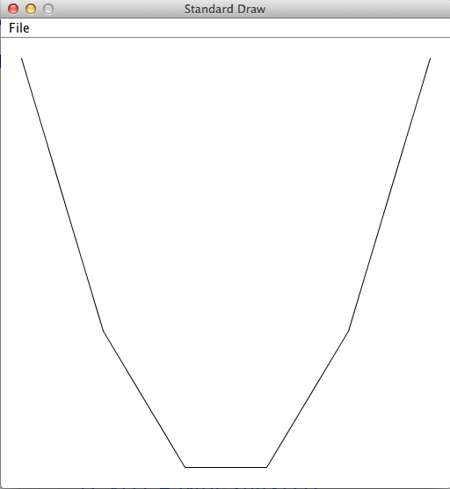
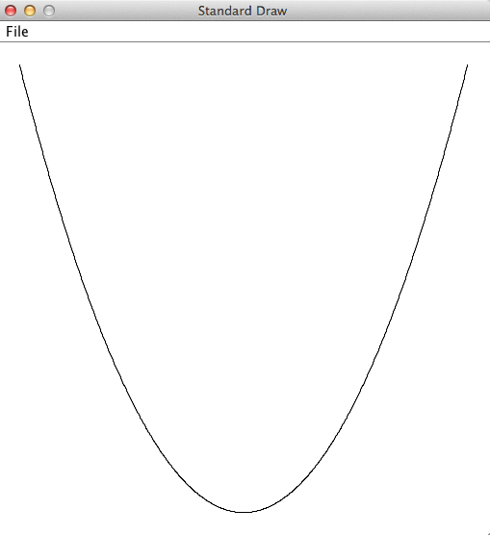
Function plotting
Function: Hard-coded into the program
Range (xMin, xMax): command-line arguments
N (number of segments): command-line argument
Plot f (x) = x²
xMin
xMax
N
% java PlotFunction -100 100 5
% java PlotFunction -100 100 1000
21

Slide 22
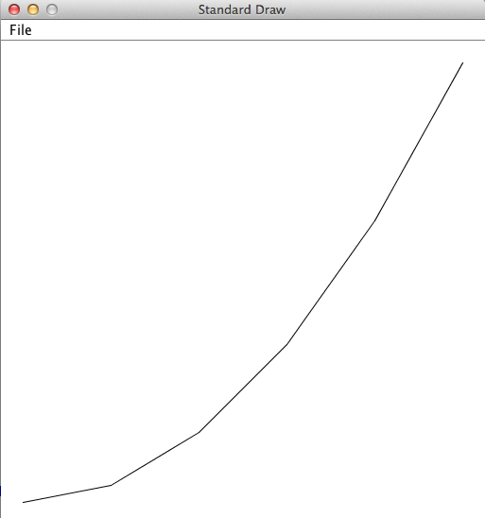
Function plotting
xMin
xMax
N
Plot f (x) = x²
% java PlotFunction 0 100 5
Algorithm
Input: xMin, xMax, N
Input (fixed in the program): f(x)
Create an N + 1 elements array containing the x values
Create an N + 1 elements array containing the f(x) values
Use line drawing to connect the resulting N + 1 (x, y) points.
(100, 10000)
(x, f(x)) points
(80, 6400)
(60, 3600)
(40, 1600)
(0, 0)
(20, 400)

Slide 23
Function plotting
/** Plots functions. */
public class PlotFunction {
// The function to plot: f(x) = x * x
public static double f(double x) {
return x * x;
}
public static void main(String[] args) {
double xMin = Double.parseDouble(args[0]);
double xMax = Double.parseDouble(args[1]);
int N = Integer.parseInt(args[2]);
// Creates arrays for the x values and the y values
double x[] = xArr(xMin, xMax, N);
double y[] = f(x);
// Scales the canvas
StdDraw.setXscale(xMin, xMax);
StdDraw.setYscale(min(y), max(y));
// Connects the (x,y) points
for (int i = 0; i < N; i++) {
StdDraw.line(x[i], y[i], x[i+1], y[i+1]);
}
}
//// More functions: On the right of this slide
}
xMin
xMax
N
% java PlotFunction 0 100 5
(100, 10000)
(x, f(x)) points
(80, 6400)
(60, 3600)
(40, 1600)
(0, 0)
(20, 400)

Slide 24
Function plotting
/** Plots functions. */
public class PlotFunction {
// The function to plot: f(x) = x * x
public static double f(double x) {
return x * x;
}
public static void main(String[] args) {
double xMin = Double.parseDouble(args[0]);
double xMax = Double.parseDouble(args[1]);
int N = Integer.parseInt(args[2]);
// Creates arrays for the x values and the y values
double x[] = xArr(xMin, xMax, N);
double y[] = f(x);
// Scales the canvas
StdDraw.setXscale(xMin, xMax);
StdDraw.setYscale(min(y), max(y));
// Connects the (x,y) points
for (int i = 0; i < N; i++) {
StdDraw.line(x[i], y[i], x[i+1], y[i+1]);
}
}
//// More functions: On the right of this slide
}
xMin
xMax
N
% java PlotFunction 0 100 5
(100, 10000)
red: x values
black: y = f(x) values
(80, 6400)
(60, 3600)
(40, 1600)
(0, 0)
(20, 400)

Slide 25
Function plotting
/** Plots functions. */
public class PlotFunction {
// The function to plot: f(x) = x * x
public static double f(double x) {
return x * x;
}
public static void main(String[] args) {
double xMin = Double.parseDouble(args[0]);
double xMax = Double.parseDouble(args[1]);
int N = Integer.parseInt(args[2]);
// Creates arrays for the x values and y values
double x[] = xArr(xMin, xMax, N);
double y[] = f(x);
// Scales the canvas
StdDraw.setXscale(xMin, xMax);
StdDraw.setYscale(min(y), max(y));
// Connects the (x,y) points
for (int i = 0; i < N; i++) {
StdDraw.line(x[i], y[i], x[i+1], y[i+1]);
}
}
//// More functions: On the right of this slide
}
// Returns an array that represents the x-axis (x ציר ה-): // N equally-spaced points between a and b
public static double[] xArr(double a, double b, int N) {
double[] x = new double[N + 1];
double interval = (b - a) / N;
for (int i = 0; i <= N; i++) {
x[i] = a + (i * interval);
}
return x;
}
// Returns the array f(x[])
public static double[] f(double x[]) {
int N = x.length;
double[] y = new double[N];
for (int i = 0; i < N; i++) {
y[i] = f(x[i]); // computes y = f(x)
}
return y;
}
// Returns the minimum value in the given array (code omitted)
public static double min(double arr[]) {
}
// Returns the maximum value in the given array (code omitted)
public static double max(double arr[]) {
}
}

Slide 26
Function plotting
/** Plots functions. */
public class PlotFunction {
// The function to plot: f(x) = x * x
public static double f(double x) {
return x * x;
}
public static void main(String[] args) {
double xMin = Double.parseDouble(args[0]);
double xMax = Double.parseDouble(args[1]);
int N = Integer.parseInt(args[2]);
// Creates arrays for the x values and y values
double x[] = xArr(xMin, xMax, N);
double y[] = f(x);
// Scales the canvas
StdDraw.setXscale(xMin, xMax);
StdDraw.setYscale(min(y), max(y));
// Connects the (x,y) points
for (int i = 0; i < N; i++) {
StdDraw.line(x[i], y[i], x[i+1], y[i+1]);
}
}
//// More functions: On the right of this slide
}
// Returns an array that represents the x-axis (x ציר ה-): // N equally-spaced points between a and b
public static double[] xArr(double a, double b, int N) {
double[] x = new double[N + 1];
double interval = (b - a) / N;
for (int i = 0; i <= N; i++) {
x[i] = a + (i * interval);
}
return x;
}
// Returns the array f(x[])
public static double[] f(double x[]) {
int N = x.length;
double[] y = new double[N];
for (int i = 0; i < N; i++) {
y[i] = f(x[i]); // computes y = f(x)
}
return y;
}
// Returns the minimum value in the given array (code omitted)
public static double min(double arr[]) {
}
// Returns the maximum value in the given array (code omitted)
public static double max(double arr[]) {
}
}

Slide 27
Function plotting
/** Plots functions. */
public class PlotFunction {
// The function to plot: f(x) = x * x
public static double f(double x) {
return x * x;
}
public static void main(String[] args) {
double xMin = Double.parseDouble(args[0]);
double xMax = Double.parseDouble(args[1]);
int N = Integer.parseInt(args[2]);
// Creates arrays for the x values and y values
double x[] = xArr(xMin, xMax, N);
double y[] = f(x);
// Scales the canvas
StdDraw.setXscale(xMin, xMax);
StdDraw.setYscale(min(y), max(y));
// Connects the (x,y) points
for (int i = 0; i < N; i++) {
StdDraw.line(x[i], y[i], x[i+1], y[i+1]);
}
}
//// More functions: On the right of this slide
}
xMin
xMax
N
% java PlotFunction 0 100 5
(100, 10000)
red: x values
black: y = f(x) values
(0, 0)

Slide 28
Function plotting
/** Plots functions. */
public class PlotFunction {
// The function to plot: f(x) = x * x
public static double f(double x) {
return x * x;
}
public static void main(String[] args) {
double xMin = Double.parseDouble(args[0]);
double xMax = Double.parseDouble(args[1]);
int N = Integer.parseInt(args[2]);
// Creates arrays for the x values and y values
double x[] = xArr(xMin, xMax, N);
double y[] = f(x);
// Scales the canvas
StdDraw.setXscale(xMin, xMax);
StdDraw.setYscale(min(y), max(y));
// Connects the (x,y) points
for (int i = 0; i < N; i++) {
StdDraw.line(x[i], y[i], x[i+1], y[i+1]);
}
}
//// More functions: On the right of this slide
}
xMin
xMax
N
% java PlotFunction 0 100 5
(100, 10000)
red: x values
black: y = f(x) values
(80, 6400)
(60, 3600)
(40, 1600)
(0, 0)
(20, 400)

Slide 29
Function plotting
/** Plots functions. */
public class PlotFunction {
// The function to plot: f(x) = x * x
public static double f(double x) {
return x * x;
}
public static void main(String[] args) {
double xMin = Double.parseDouble(args[0]);
double xMax = Double.parseDouble(args[1]);
int N = Integer.parseInt(args[2]);
// Creates arrays for the x values and y values
double x[] = xArr(xMin, xMax, N);
double y[] = f(x);
// Scales the canvas
StdDraw.setXscale(xMin, xMax);
StdDraw.setYscale(min(y), max(y));
// Connects the (x,y) points
for (int i = 0; i < N; i++) {
StdDraw.line(x[i], y[i], x[i+1], y[i+1]);
}
}
//// More functions: On the right of this slide
}
xMin
xMax
N
% java PlotFunction 0 100 5

Slide 30
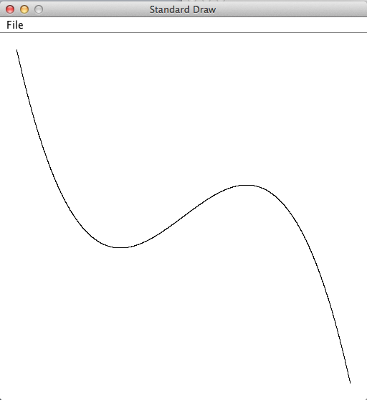
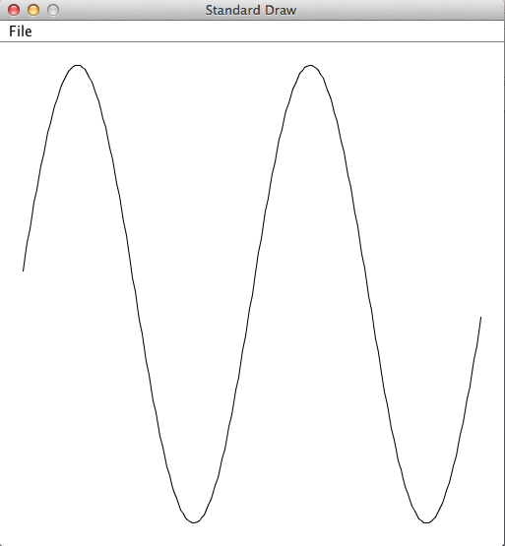
Function plotting
Plot f (x) = –7x³ + 3x + 2
Plot f (x) = sin(x) in the range ($−2π, +2π$)
% java PlotFunction -2 2 100
% java PlotFunction -6.28 6.28 100

Slide 31
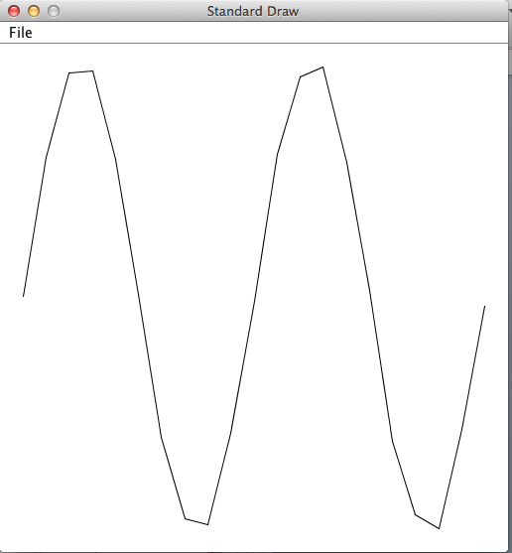
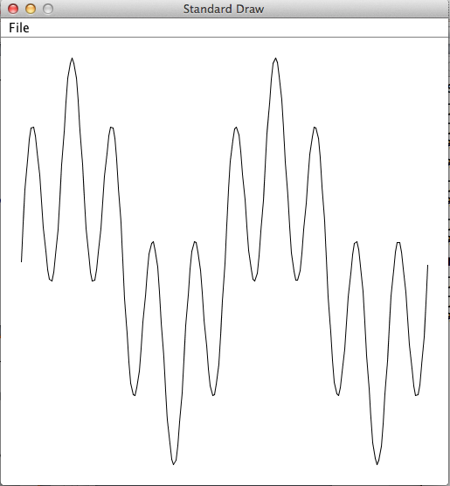
Function plotting
Plot
public class PlotFunction {
// The function to plot: f(x) = sin(4x) + sin(20x)
public static double f(double x) {
return Math.sin(4*x) + Math.sin(20*x);
}
public static void main(String[] args) {
...
% java PlotFunction 0 3.14 20
% java PlotFunction 0 3.14 200
One lesson...
visual imaging of data (like linear interpolation) can be tricky;
when shown a data-driven visual, always demand to see the data.

Slide 32
Introduction to Computer Science
Reichman University
Lecture 5-2
Multimedia, Part I
Notes:
32

